Slide 1
The 8 Health Standards
Mrs. Simpson’s Health Class

Slide 2
What is a ‘Standard?’
The Department of Public Instruction gives standards for each subject in order to guide schools in what should be taught in each area.
This helps to streamline education to be similar for all areas.
Example: All students who complete algebra should be able to represent and solve equations and inequalities graphically. This skill, then will be taught in Kenosha, Eau Claire, Appleton etc.

Slide 3
Health Standards
Standard 1 – Core Concepts
Standard 2 – Analyzing Influences
Standard 3 – Accessing Information
Standard 4 – Interpersonal Communication
Standard 5 – Decision Making
Standard 6 – Goal Setting
Standard 7 – Self Management
Standard 8 – Advocacy
*Then within these standards there are topics i.e. By 10th grade students should learn these 8 skills regarding tobacco, alcohol, violence etc.

Slide 4
Core Concepts – Factual Knowledge / Think Trivia
Knowledge Based (Can you answer all of these?)
Alcohol and Other Drugs
Ex. The drug category for heroin is ______________
Healthy Eating
__________ is a nutrient that your body doesn’t digest
Mental and Emotional Health
____________ is good stress, Distress is bad stress
Personal Health and Wellness
Coughing into your elbow is a way to prevent ________________
Physical Activity
Exercises like yoga and Pilates will focus most on the _______________ category of fitness
Safety
______________ is the emergency number for the Osseo-Fairchild area
Sexual Health
_______________ is the only 100% way that you can control to prevent pregnancy and STIs
Tobacco
Emphysema is a _________ disorder caused by smoking
Violence Prevention
Repeated harassment that is done online or through text messaging is called __________________

Slide 5
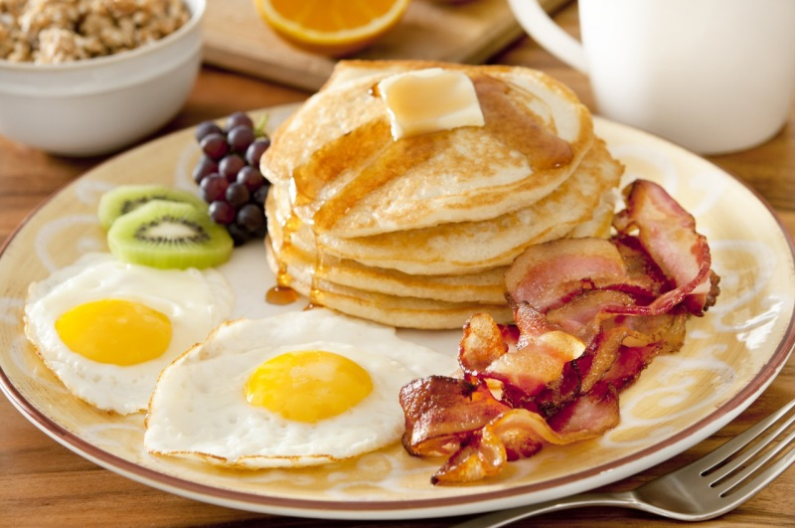
Analyzing Influences – Why You Do What You Do
Take out your phones….yes this is ok.
Text someone who you think will respond
Ask them, “What did you have for breakfast and why?”
Discuss how does _____________ influence our food choices?

Slide 6
Accessing Information – Getting Accurate Information
https://youtu.be/Nso0m-1OJ5w
This clip was posted by a friend of mine on social media in efforts to discourage excessive use of energy drinks. Don’t watch it if body stuff bothers you.

Slide 7
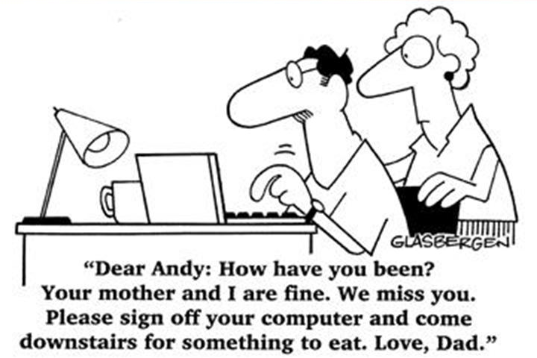
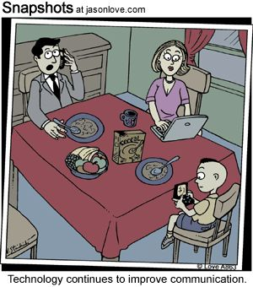
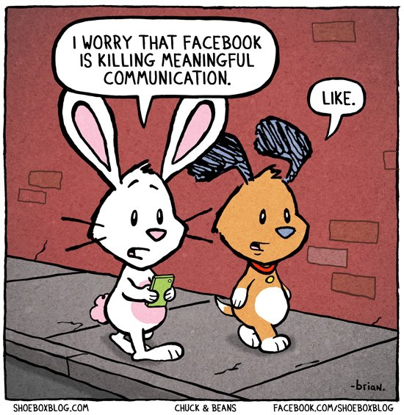
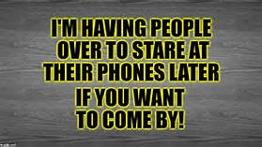
Interpersonal Communication – Communication Skills
Expressing yourself in an effective way

Slide 8
Decision Making Skills – Making Informed Choices
Beanboozled
Will you try it? Why or why not?

Slide 9
Goal Setting – Making a Goal and Setting up a Plan
Discuss with your neighbor what you want to do for a living?
Discuss with your neighbor at least one thing you need to do to achieve that goal?
Use the SMART Acronym
S = Specific
M = Measurable
A = Ambitious
R = Realistic
T = Timely

Slide 10
Self Management – Putting it Into Practice and Holding Yourself Accountable
Parenting.com’s 12 Things a Kid Should Be Able to Do For Themselves By High School
Make a Meal
Wake Themselves Up
Do Laundry
Pump Gas
Pitch In
Advocate for Themselves
Pack Their Own Bag
Order at Restaurants
Talk to (Safe) Strangers
Plan an Outing
Go Grocery Shopping
Take Public Transportation

Slide 11
Advocacy – Standing Up for What you Believe in and Influencing Others in a Good Way
Come Up With an Argument Made to a Health Teacher Advocating for Regular Open Campus

